Slide 1
Microservices
Chapter 4

Slide 2
Agenda
By the end of this chapter, you:
Will have some knowledge about applying microservice concepts
Will have “hands-on” experience on microservice architecture of a real world case for migrating monolithic systems to microservices-based ones, with the BrownField Airline's PSS application as an example
Will learn various approaches and transition strategies for migrating a monolithic application to microservices
Will Design a new futuristic microservices system to replace the PSS application using Spring Framework components

Slide 3
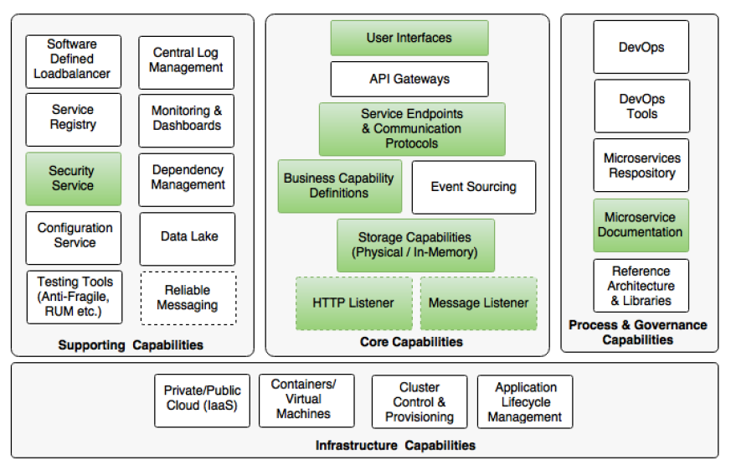
Microservice Capabilities

Slide 4
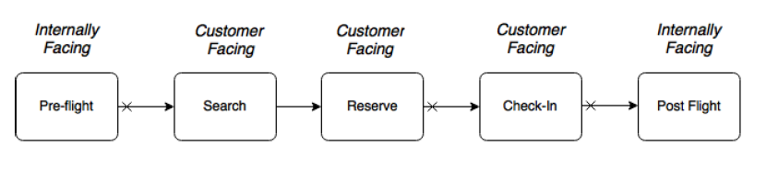
Monolithic PSS Business Overview
Notes:
The current solution is automating certain customer-facing functions as well as certain internally facing functions.
Pre-flight functions include the planning phase, used for preparing flight schedules, plans, aircrafts, and so on.
Post-flight functions are used by the back office for revenue management, accounting, and so on.
The Search and Reserve functions are part of the online seat reservation process, and the Check-in function is the process of accepting passengers at the airport.
The Check-in function is also accessible to the end users over the Internet for online check-in.
The cross marks at the beginning of the arrows in the preceding diagram indicate that they are disconnected, and occur at different timelines. For example, passengers
are allowed to book 360 days in advance, whereas the check-in generally happens 24 hours before flight departure.

Slide 5
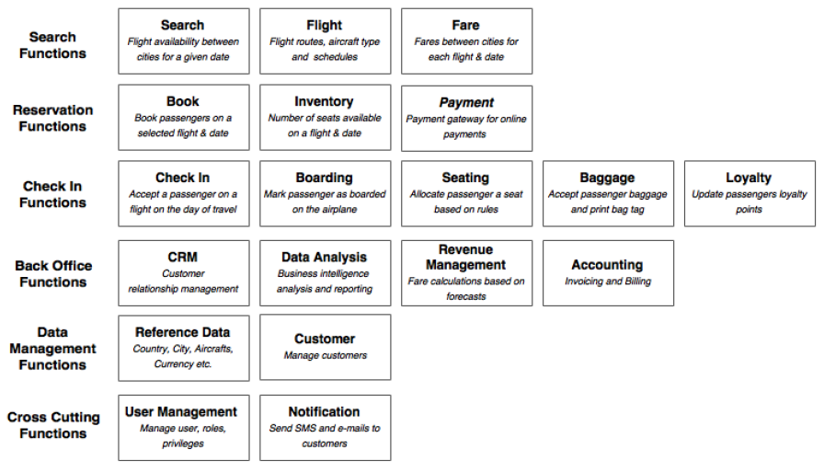
Functional View

Slide 6
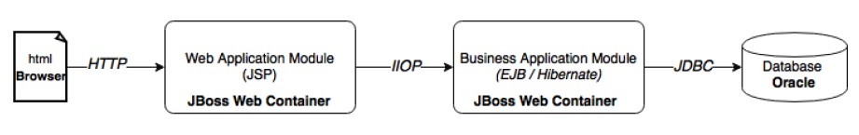
Architecture View
Notes:
This was done 10 years ago, using state of the art technologies.
The architecture has well-defined boundaries. Also, different concerns are separated into different layers. The web application was developed as an N-tier, component-based modular system.
The functions interact with each other through well-defined service contracts defined in the form of EJB endpoints.
IIOP (Internet Inter-ORB Protocol) is a protocol that makes it possible for distributed programs written in different programming languages to communicate over the Internet. IIOP is a critical part of a strategic industry standard, the Common Object Request Broker Architecture (CORBA). Using CORBA's IIOP and related protocols, a company can write programs that will be able to communicate with their own or other company's existing or future programs wherever they are located and without having to understand anything about the program other than its service and a name. CORBA and IIOP are competing with a similar strategy from Microsoft called the Distributed Component Object Model (DCOM). (Microsoft and the Object Management Group, sponsors of CORBA, have agreed to develop software bridges between the two models so that programs designed for CORBA can communicate with programs designed for DCOM.)

Slide 7
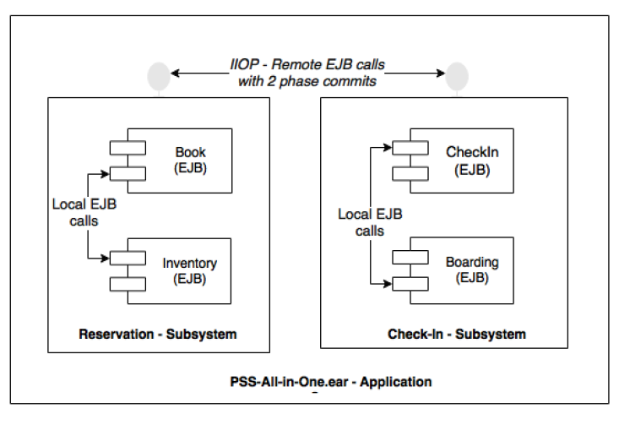
Design View
Notes:
The two-phase commit protocol (2PC) is a type of atomic commitment protocol (ACP). It is a distributed algorithm that coordinates all the processes that participate in a distributed atomic transaction on whether to commit or abort (roll back) the transaction (it is a specialized type of consensus protocol).
The protocol works in the following manner: one node is a designated coordinator, which is the master site, and the rest of the nodes in the network are designated the cohorts. The protocol assumes that there is stable storage at each node with a write-ahead log, that no node crashes forever, that the data in the write-ahead log is never lost or corrupted in a crash, and that any two nodes can communicate with each other. The last assumption is not too restrictive, as network communication can typically be rerouted. The first two assumptions are much stronger; if a node is totally destroyed then data can be lost.
The protocol is initiated by the coordinator after the last step of the transaction has been reached. The cohorts then respond with an agreement message or an abort message depending on whether the transaction has been processed successfully at the cohort.
The greatest disadvantage of the two-phase commit protocol is that it is a blocking protocol. If the coordinator fails permanently, some cohorts will never resolve their transactions: After a cohort has sent an agreement message to the coordinator, it will block until a commit or rollback is received.
Note that the two-phase commit (2PC) protocol should not be confused with the two-phase locking (2PL) protocol, a concurrency control protocol, which is a concurrency control method that guarantees serializability
It is also the name of the resulting set of database transaction schedules (histories). The protocol utilizes locks, applied by a transaction to data, which may block (interpreted as signals to stop) other transactions from accessing the same data during the transaction's life.
By the 2PL protocol, locks are applied and removed in two phases:
1- Expanding phase: locks are acquired and no locks are released.
2- Shrinking phase: locks are released and no locks are acquired.
Two types of locks are utilized by the basic protocol: Shared and Exclusive locks. Refinements of the basic protocol may utilize more lock types. Using locks that block processes, 2PL may be subject to deadlocks that result from the mutual blocking of two or more transactions.

Slide 8
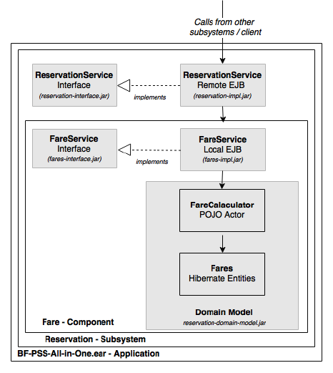
Implementation View
Notes:
In the preceding diagram, the gray-shaded boxes are treated as different Maven projects, and translate into physical artifacts.
Subsystems and components are designed adhering to the program to an interface principle.
Interfaces are packaged as separate JAR files so that clients are abstracted from the implementations.
The complexity of the business logic is buried in the domain model.
Local EJBs are used as component interfaces.
Finally, all subsystems are packaged into a single all-in-one EAR, and deployed in the application server.

Slide 9
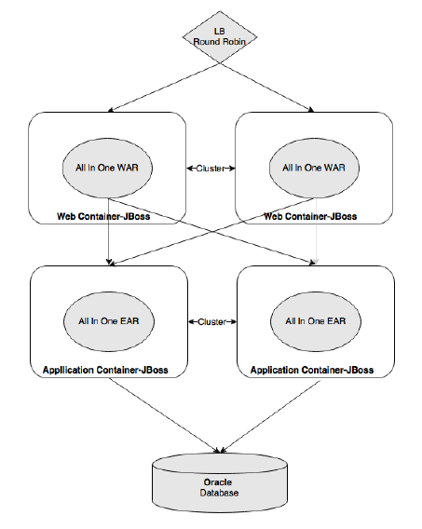
Deployment View
Notes:
The web modules and business modules were deployed into separate application server clusters. The application was scaled horizontally by adding more and more application servers to the cluster.
Zero downtime deployments were handled by creating a standby cluster, and gracefully diverting the traffic to that cluster. The standby cluster is destroyed once
the primary cluster is patched with the new version and brought back to service.
Most of the database changes were designed for backward compatibility, but breaking changes were promoted with application outages.

Slide 10
Death of the monolith
System was performing well until:
The business has seen tremendous growth over a period of time.
The fleet size increased significantly
New destinations got added to the network.
As a result of this rapid growth, the number of bookings has gone up, resulting in a steep increase in transaction volumes, up to 200 - to 500 - fold of what was originally estimated.
Notes:
The rapid growth of the business eventually put the application under pressure.
Odd stability issues and performance issues surfaced.
New application releases started breaking the working code.
Moreover, the cost of change and the speed of delivery started impacting the business operations profoundly.

Slide 11
PSS weakness points
Stability
stuck threads:
limit the application server's capability to accept more transactions
They are mainly due to database table locks.
Memory issues
Resource intensive operations
Outage
large size of the EAR = Server startup time increased
single EAR = full redeployment in case of small code change
Complexity of Zero downtime + Server Startup time = outage
Agility
Complexity of code, because of lack of discipline in implementing the changes
Changes became harder to implement
The impact analysis became too complex to perform
application build time went up severely causing unacceptable drops in development productivity
This led to difficulty in build automation and eventually stopped continuous integration (CI) and unit testing.

Slide 12
Retrospection
PSS was well architected
There was a clear segregation between the functional components
Functional components were loosely coupled
Functional components were programmed to interfaces, with access through standards-based interfaces,
Functional components had had a rich domain model

Slide 13
What Went Wrong
How come such a well-architected application failed to live up to the expectations?
What else could the architects have done?

Slide 14
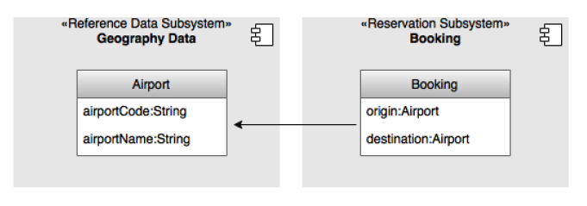
Problems
Shared Data
all functional modules require reference data*
Much of this reference data is neither fully static nor fully dynamic
One of the common usage scenarios of reference data is to filter the operational data based on certain reference data**
Notes:
* For example, fare is calculated based on the point of origin (city), a flight is between an origin and a destination (airports), check-in is at the origin airport (airport), and so
on.
* In some functions, the reference data is a part of the information model, whereas in some other functions, it is used for validation purposes.
** For instance, say a user wishes to see all the flights to a country. In this case, the flow of events could be as follows: find all the cities in the selected country, then all airports in the cities, and then fire a request to get all the flights to the list of resulting airports identified in that country.
The architects considered multiple approaches when designing the system.
Separating the reference data as an independent subsystem like other subsystems was one of the options considered, but this could lead to performance issues.
The team took the decision to follow an exception approach for handling reference data as compared to other transactions. Considering the nature of the query patterns discussed earlier, the approach was to use the reference data as a shared library.
In this case, the subsystems were allowed to access the reference data directly using pass-by-reference semantic data instead of going through the EJB interfaces. This also meant that irrespective of the subsystems, hibernate entities could use the reference data as a part of their entity relationships (just introduce relationship using hibernate for example)

Slide 15
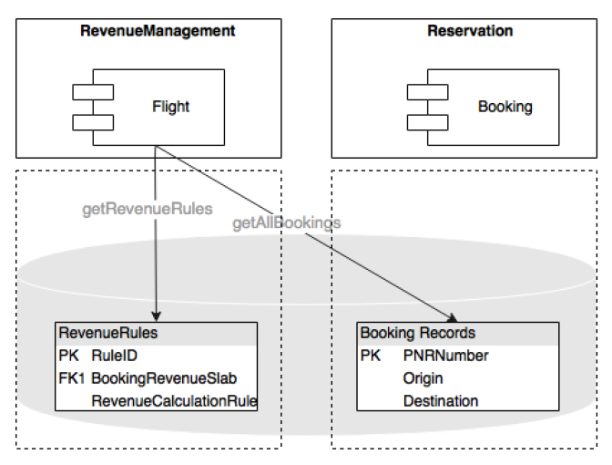
Problems
Single Database
Native Queries:
an easy-to-implement shortcut
This approach could reduce the number of
calls from N+1 to a single database call,
with minimal coding efforts.
This resulted not only in tightly coupled
components, but also led to undocumented,
hard-to-detect code.
Notes:
Accounting component requires all booking records for a day, for a given city, from the Booking component to process the day-end billing. The subsystem-based design enforces Accounting to make a service call to Booking to get all booking records for a given city.
Assume this results in N booking records. Now, for each booking record, Accounting has to execute a database call to find the applicable rules based on the fare code attached to each booking record. This could result in N+1 JDBC calls, which is inefficient.
Workarounds, such as batch queries or parallel and batch executions, are available, but this would lead to increased coding efforts and higher complexity.

Slide 16
Problems
Single Database
Stored Procedures
Implement logic directly within the stored procedures
This decision resulted in better performance of some of the transactions,
Also removed some of the stability issues.
However, this eventually broke the application's modularity.
Notes:
Some of the complex data-centric logic written at the middle layer was not performing well, causing slow response, memory issues, and thread-blocking issues.

Slide 17
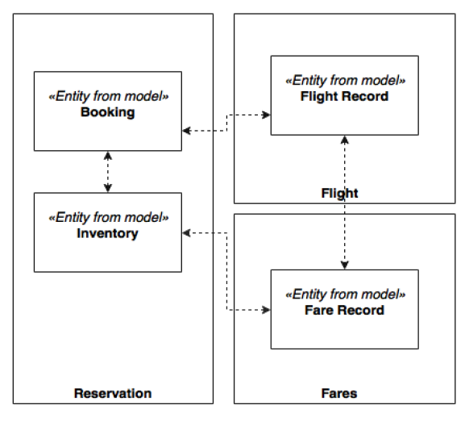
Problems
Domain boundaries
Though all the components were set to run on a single
container, there was no stopping the developers
referencing objects across these boundaries
Over a period of time, the project teams changed,
delivery pressure increased, and the complexity grew
tremendously.
The developers started looking for quick solutions
rather than the right ones.
Slowly, but steadily, the modular nature of the
application went away
Notes:
Some of the complex data-centric logic written at the middle layer was not performing well, causing slow response, memory issues, and thread-blocking issues.

Slide 18
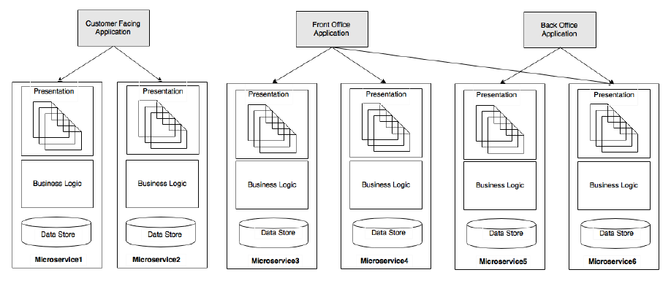
Microservices Approach
Microservices is an ideal choice for transforming a legacy monolithic application with minimal disruption to the business
Notes:
Each microservice will hold the data store, the business logic, and the presentation layer.
The approach is to build a number of web portal applications targeting specific user communities such as customer facing, front office, and back office.
The advantage of this approach lies in the flexibility for modeling, and also in the possibility to treat different communities differently.
For example, the policies, architecture, and testing approaches for the Internet facing layer are different from the intranet-facing web application.
Internet-facing applications may take advantage of CDNs (Content Delivery Networks) to move pages as close to the customer as possible,
whereas intranet applications could serve pages directly from the data center.

Slide 19
Critical Microservice Benefits
Service dependencies
Physical boundaries
Selective scaling
Technology obsolescence
Notes:
Service dependencies
Dependencies are better known
Lessons from the monolithic application helps architects and developers to design a better system.
Physical boundaries
Microservices enforce physical boundaries in all areas including the data store, the business logic, and the presentation layer.
Selective scaling
This provides a much more cost-effective scaling mechanism compared to the Y-scale approach used in the monolithic scenario
Technology obsolescence
Technology migrations could be applied at a microservices level rather than at the overall application level.

Slide 20
How do we break it?
It is not simple to break an application that has millions of lines of code, especially if the code has complex dependencies.
How do we break it?
More importantly, where do we start, and how do we approach this problem?

Slide 21
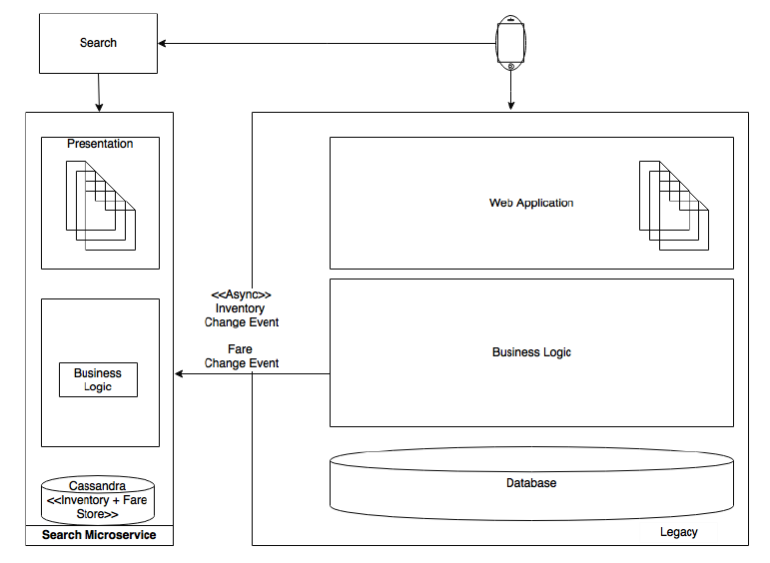
Evolutionary approach
Notes:
The best way to address this problem is to establish a transition plan, and gradually migrate the functions as microservices. At every step, a microservice will be created outside of the monolithic application, and traffic will be diverted to the new service

Slide 22
What Should be done ?
Identification of microservices' boundaries
Prioritizing microservices for migration
Handling data synchronization during the transition phase
Handling user interface integration, working with old and new user interfaces
Handling of reference data in the new system
Testing strategy to ensure the business capabilities are intact and correctly reproduced
Identification of any prerequisites for microservice development such as microservices capabilities, frameworks, processes, and so on

Slide 23
Identification of microservices boundaries
A top-down approach is typically used for domain decomposition
The bottom-up approach is also useful in the case of breaking an existing system
it can utilize a lot of practical knowledge, functions, and behaviors of the existing monolithic application.
This will give a potential list of microservices (not a final list of microservices, but it serves as a good starting point )

Slide 24
Analyze dependencies
At the end of this activity, a dependency graph will be produced.
This could be done by combining one or more of the approaches listed as follows:
Analyze the manual code and regenerating dependencies.
Use the experience of the development team to regenerate dependencies.
Use a Maven dependency graph. There are a number of tools we could use to regenerate the dependency graph, such as PomExplorer, PomParser, and so on.
Using performance engineering tools such as AppDynamics to identify the call stack and roll up dependencies.

Slide 25
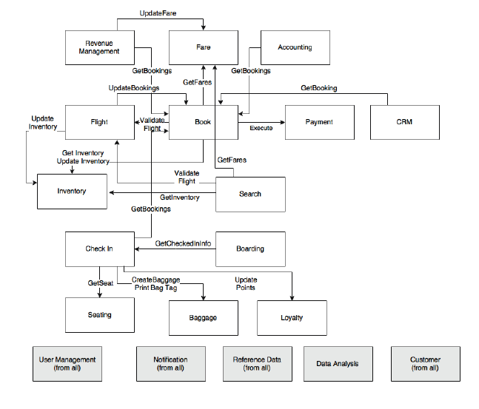
PSS. example

Slide 26
Events as opposed to query
Dependencies could be query-based or event-based.
Event-based is better for scalable systems.
Sometimes, it is possible to convert query-based communications to event-based ones.
In many cases, these dependencies exist because either the business organizations are managed like that, or by way the old system handled the business scenario.

Slide 27
Events as opposed to synchronous updates
In this approach, send new bookings and the changes in bookings as soon as they take place in the Booking module as an asynchronous push (rather than in a batch job/scheduler).
The same pattern could be applied in many other scenarios such as from Booking to Accounting, from Flight to Inventory, and also from Flight to Booking.
In this approach, the source service publishes all state-change events to a topic. All interested parties could subscribe to this event stream and store locally.
This approach removes many hard wirings, and keeps the systems loosely coupled.

Slide 28
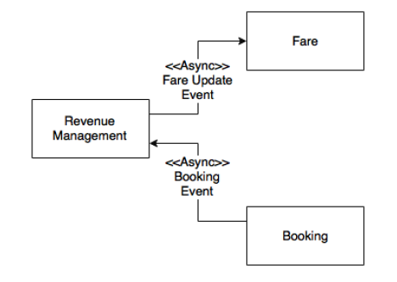
Events as opposed to synchronous updates (Cont.)
Notes:
If we applied this, it may leave a hole in the consistent state of the application, but this will be addressed later on.

Slide 29
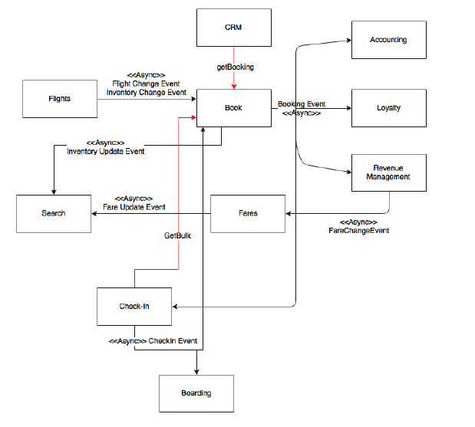
Final dependency graph
Notes:
There are still a few synchronized calls, which, for the time being, we will keep as they are.
By applying all these changes, the final dependency diagram over there
Now we can safely consider each box as a separate “Microservice”.

Slide 30
Prioritizing microservices for migration
Dependency
Transaction volume
Resource utilization
Complexity
Business criticality
Velocity of changes
Innovation
Notes:
Here, will analyze the priorities, and identify the order of migration.
Dependency: One of the parameters for deciding the priority is the dependency graph. From the service dependency graph, services with less dependency or no dependency at all are easy to migrate, whereas complex dependencies are way harder. Services with complex dependencies will also need dependent modules to be migrated along with them.
Accounting, Loyalty, CRM, and Boarding have less dependencies as compared to Booking and Check-in. Modules with high dependencies will also have higher risks in their migration.
Transaction volume: Another parameter that can be applied is analyzing the transaction volumes. Migrating services with the highest transaction volumes will relieve the load on the existing system. This will have more value from an IT support and maintenance perspective. However, the downside of this approach is the higher risk factor.
As stated earlier, Search requests are ten times higher in volume as compared to Booking requests. Requests for Check-in are the third-highest in volume transaction after Search and Booking.
Resource utilization: Resource utilization is measured based on the current utilizations such as CPU, memory, connection pools, thread pools, and so on. Migrating resource intensive services out of the legacy system provides relief to other services. This helps the remaining modules to function better.
Flight, Revenue Management, and Accounting are resource-intensive services, as they involve data-intensive transactions such as forecasting, billing, flight schedule changes, and so on.
Complexity: Complexity is perhaps measured in terms of the business logic associated with a service such as function points, lines of code, number of tables, number of services, and others. Less complex modules are easy to migrate as compared to the more complex ones.
Booking is extremely complex as compared to the Boarding, Search, and heck-in services.
Business criticality: The business criticality could be either based on revenue or customer experience. Highly critical modules deliver higher business value.
Booking is the most revenue-generating service from the business stand point, whereas Check-in is business critical as it could lead to flight departure delays, which could lead to revenue loss as well as customer dissatisfaction.
Velocity of changes: Velocity of change indicates the number of change requests targeting a function in a short time frame. This translates to speed and agility of delivery. Services with high velocity of change requests are better candidates for migration as compared to stable modules.
Statistics show that Search, Booking, and Fares go through frequent changes, whereas Check-in is the most stable function.
Innovation: Services that are part of a disruptive innovative process need to get priority over back office functions that are based on more established business processes. Innovations in legacy systems are harder to achieve as compared to applying innovations in the microservices world.
Most of the innovations are around Search, Booking, Fares, Revenue Management, and Check-in as compared to back office Accounting.

Slide 31
Based on BrownField's analysis, Search has the highest priority, as it requires innovation, has high velocity of changes, is less business critical, and gives better relief for both business and IT. The Search service has minimal dependency with no requirements to synchronize data back to the legacy system.

Slide 32
Data synchronization during migration
During the transition phase, the legacy system and the new microservices will run in parallel. Therefore, it is important to keep the data synchronized between the two systems.
Solution:
synchronize the data between the two systems at the database level by using any data synchronization tool.
This approach works well when both the old and the new systems are built on the same data store technologies.
The complexity will be higher if the data store technologies are different.
The second problem with this approach is that we allow a backdoor entry, hence exposing the microservices' internal data store outside. This is against the principle of microservices.

Slide 33
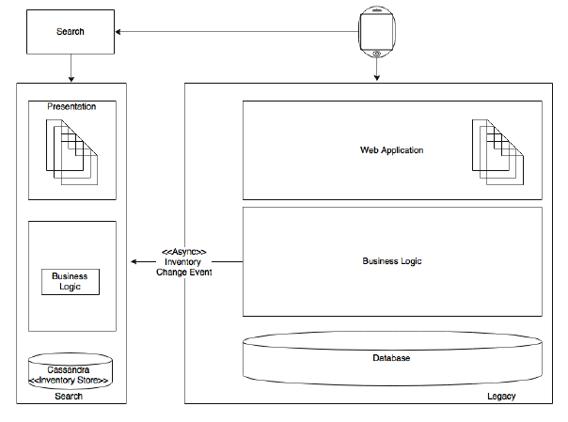
Search
Notes:
We will have to make some changes in the existing system to send the fare changes or any inventory changes as events.
The Search service then accepts these events, and stores them locally into the local NoSQL store.

Slide 34
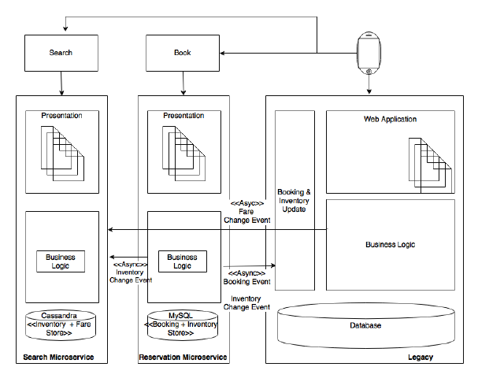
Booking
Notes:
In this case, the new Booking microservice sends the inventory change events to the Search service.
In addition to this, the legacy application also has to send the fare change events to Search. Booking will then store the new Booking service in its My SQL data store.
the Booking service has to send the booking events and the inventory events back to the legacy system. This is to ensure that the functions in the legacy system continue to work as before.
The simplest approach is to write an update component which accepts the events and updates the old booking records table so that there are no changes required in the other legacy modules.
We will continue this until none of the legacy components are referring the booking and inventory data. This will help us minimize changes in the legacy system, and therefore, reduce the risk of failures.

Slide 35
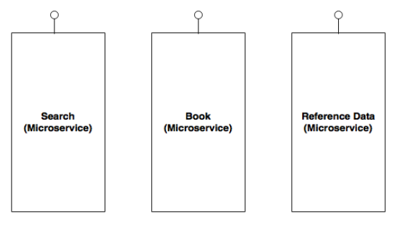
Managing reference data
A simple approach is to build the reference data as another microservice itself
But, this could lead to performance issues as encountered in the original legacy system.

Slide 36
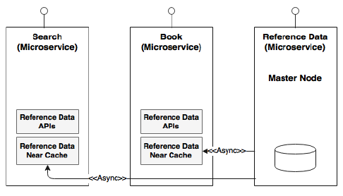
An alternate approach is to have reference data as a microservice service for all the admin and CRUD functions.
A near cache will then be created under each service to incrementally cache data from the master services. A thin reference data access proxy library will be embedded in each of these services.
The reference data access proxy abstracts whether the data is coming from cache or from a remote service
The master node in the given diagram is the actual reference data microservice
Notes:
The challenge is to synchronize the data between the master and the slave.
A subscription mechanism is required for those data caches that change frequently.

Slide 37
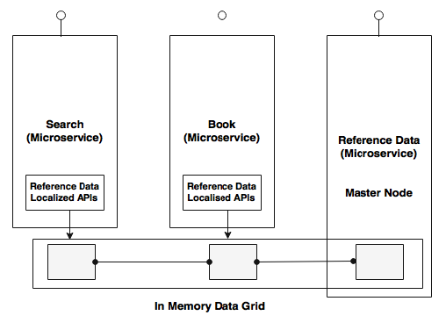
A better approach is to replace the local cache with an in-memory data grid
The reference data microservice will write to the data grid, whereas the proxy libraries embedded in other services will have read-only APIs.
This eliminates the requirement to have subscription of data, and is much more efficient and consistent.

Slide 38
User interfaces and web applications
There are three approaches here:
The first approach is to have the old and new user interfaces as separate user applications with no link between them
Very simple
No single sign on
The second approach is to use the legacy user interface as the primary application, and then transfer page controls to the new user interfaces when the user requests pages of the new application
users will get a seamless experience
SSO has to be implemented between the old and the new user interfaces.
The third approach is to integrate the existing legacy user interface directly to the new microservices backend
new microservices are built as headless applications with no presentation layer
may require many changes in the old user interface such as introducing service calls, data model conversions, and so on.

Slide 39
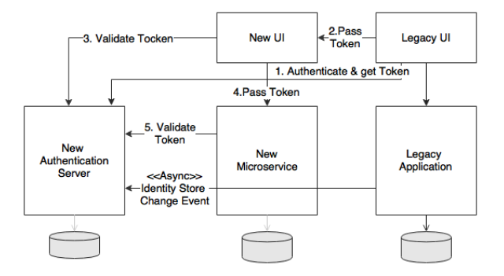
Session handling and security
Notes:
Assume that the new services are written based on Spring Security with a token-based authorization strategy, whereas the old application uses a custom-built authentication with its local identity store.
Simplest approach is to build a new identity store with an authentication service as a new microservice using Spring Security. This will be used for all our future resource and service protections, for all microservices.
The catch here is that the legacy identity store has to be synchronized with the new one.

Slide 40
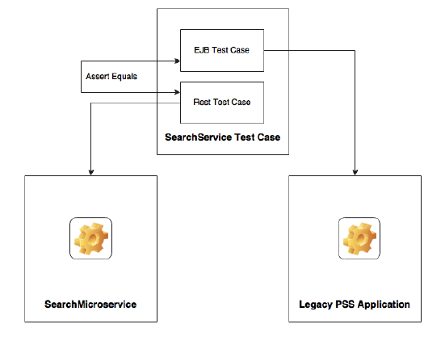
Test strategy
For each service we need one test against the EJB endpoint, and another one against the microservices endpoint
Notes:
One important question to answer from a testing point of view is how can we ensure that all functions work in the same way as before the migration?
Integration test cases should be written for the services that are getting migrated before the migration or refactoring. This ensures that once migrated, we get the same expected result, and the behavior of the system remains the same.
An automated regression test pack has to be in place, and has to be executed every time we make a change in the new or old system.
for each service we need one test against the EJB endpoint, and another one against the microservices endpoint

Slide 41
Migrate modules only if required
It is important to understand that it is not necessary to migrate all modules to the new microservices architecture, unless it is really required
Reason: might incur cost

Slide 42
What’s Next?
BrownField has already taken a decision to use an external revenue management system in place of the PSS revenue management function.
BrownField is also in the process of centralizing their accounting functions, and therefore, need not migrate the accounting function from the legacy system.
Migration of CRM does not add much value at this point to the business. Therefore, it is decided to keep the CRM in the legacy system itself.
The business has plans to move to a SaaS-based CRM solution as part of their cloud strategy.
Also note that stalling the migration halfway through could seriously impact the complexity of the system.

Slide 43
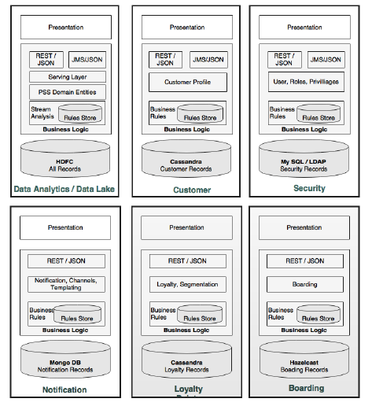
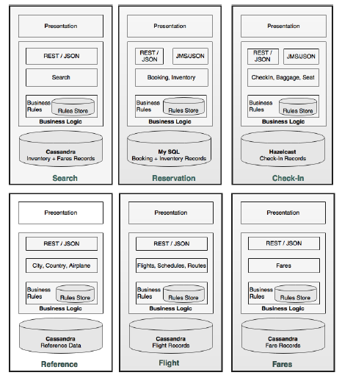
Target architecture
Notes:
The shaded boxes are core microservices, and the others are supporting microservices.
User management is moved under security in the target architecture

Slide 44
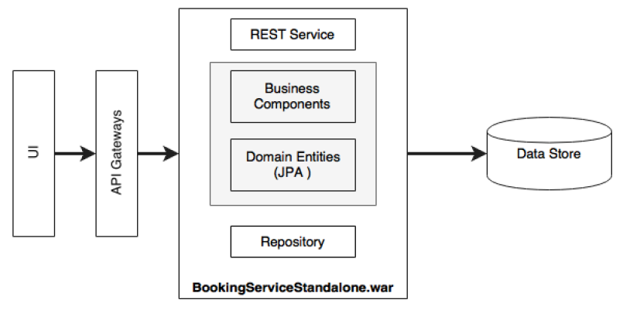
Internal layering of microservices
Notes:
The UI accesses REST services through a service gateway.
The API gateway may be one per microservice or one for many microservices—it depends on what we want
to do with the API gateway.
There could be one or more rest endpoints exposed by microservices.
These endpoints, in turn, connect to one of the business components within the service.
Business components then execute all the business functions with the help of domain entities.
A repository component is used for interacting with the backend data store.

Slide 45
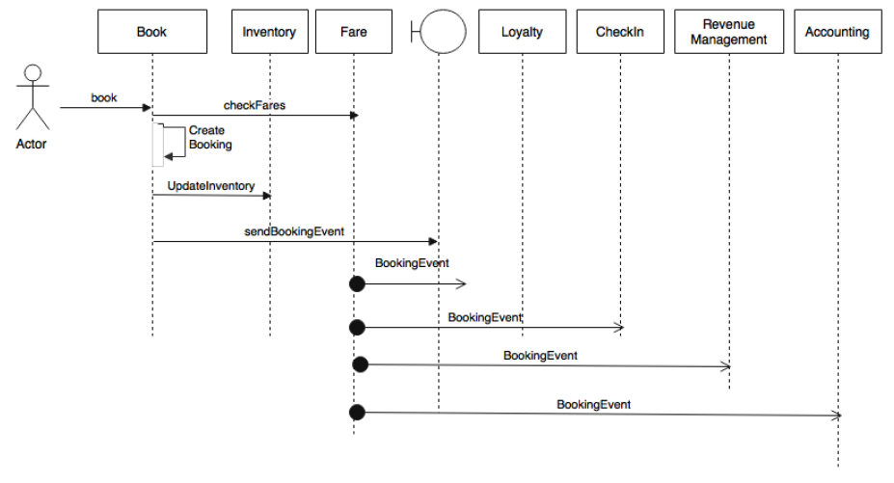
Orchestrating microservices

Slide 46
Integration with other systems
In the microservices world, we use an API gateway or a reliable message bus for integrating with other non-microservices.
Notes:
Let us assume that there is another system in BrownField that needs booking data.
Unfortunately, the system is not capable of subscribing to the booking events that the Booking microservice publishes.
In such cases, an Enterprise Application integration (EAI) solution could be employed, which listens to our booking events, and then uses a native adaptor to update the database

Slide 47
Managing shared libraries
Certain business logic is used in more than one microservice.
Search and Reservation, in this case, use inventory rules.
In such cases, these shared libraries will be duplicated in both the microservices.

Slide 48
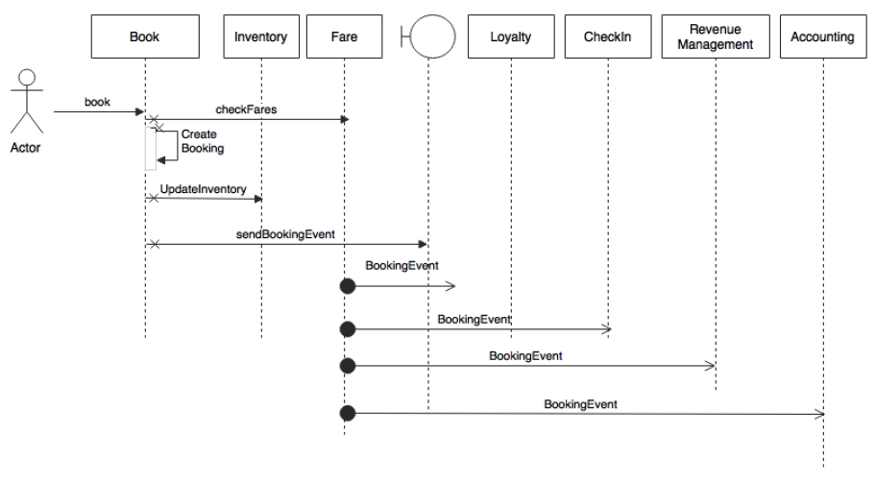
Handling exceptions
Notes:
There is a synchronous communication between Booking and Fare. What if the Fare service is not available? If the Fare service is not available, throwing an error back
to the user may cause revenue loss. An alternate thought is to trust the fare which comes as part of the incoming request. When we serve search, the search results will
have the fare as well. When the user selects a flight and submits, the request will have the selected fare.
In case the Fare service is not available, we trust the incoming request, and accept the Booking. We will use a circuit breaker and a fallback service which simply creates the booking with a special status, and queues the booking for manual action or a system retry.
What if creating the booking fails? If creating a booking fails unexpectedly, a better option is to throw a message back to the user. We could try alternative options, but
that could increase the overall complexity of the system. The same is applicable for inventory updates.
In the case of creating a booking and updating the inventory, we avoid a situation where a booking is created, and an inventory update somehow fails.
As the inventory is critical, it is better to have both, create booking and update inventory, to be in a local transaction.
This is possible as both components are under the same subsystem.

Slide 49
What if the Fare service is not available?
Accept the Booking.
Use a circuit breaker and a fallback service
Queue the booking for manual action or a system retry

Slide 50
What if creating the booking fails?
A possible way is to throw a message back to the user
The same is applicable for inventory updates

Slide 51
What if creating a booking and updating the inventory simultaneously
create booking and update inventory, to be in a local transaction.
This is possible as both components are under the same subsystem

Slide 52
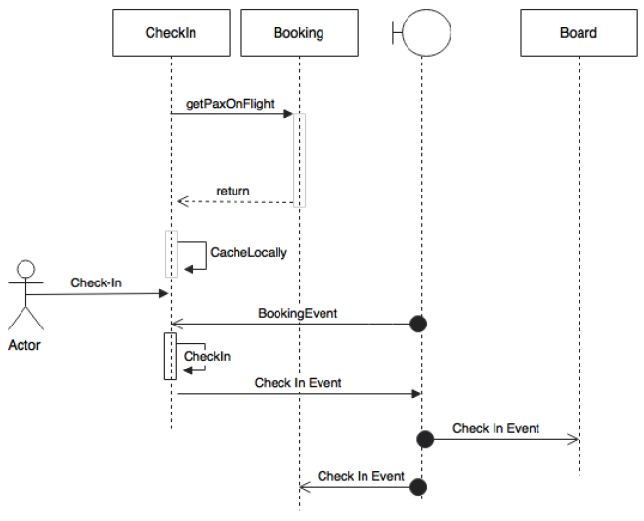
Check-In Scenario
Notes:
Consider a scenario where the Check-in services fail immediately after the Check-in Complete event is sent out. The other consumers processed this event, but the actual
check-in is rolled back. This is because we are not using a two-phase commit.
In this case, we need a mechanism for reverting that event. This could be done by catching the exception, and sending another Check-in Cancelled event.
In this case, note that to minimize the use of compensating transactions, sending the Check-in event is moved towards the end of the Check-in transaction. This reduces
the chance of failure after sending out the event.

Slide 53
What if Check-In fails after event is sent out?
Using a two-phase commit

Slide 54
what if the check-in is successful, but sending the event failed?
1- invoke a fallback service to store it locally, and then use another sweep-and-scan program to send the event at a later time. It could retry multiple times.
Pros:
better for the system's health
Cons:
This could add more complexity and may not be efficient in all cases
2- throw the exception back to the user so that the user can retry
Cons:
might not always be good from a customer engagement standpoint

Slide 55
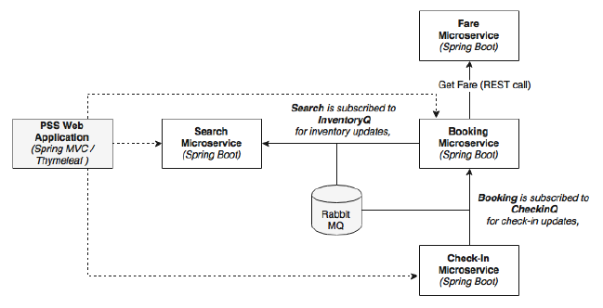
Target Implementation View
Notes:
1- four microservices
Search, Fare, Booking, and Check-in.
2- for testing: a testing application is developed using Spring MVC with Thymeleaf templates
3- The asynchronous messaging is implemented with the help of RabbitMQ.
4- H2 database is used as the in-memory store

Slide 56
Implementation Projects
Check out pages [195:200] to see how to run and test the code at https://github.com/PacktPublishing/Spring-Microservices/tree/master/Chapter%204

